Slide 1

Customer ratings analysis and insights
23-January-2023

Slide 2

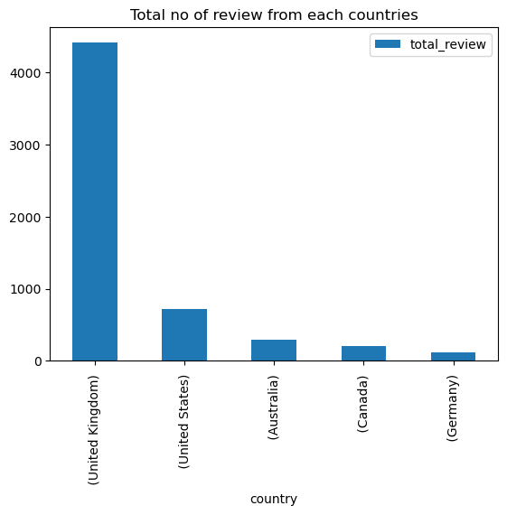
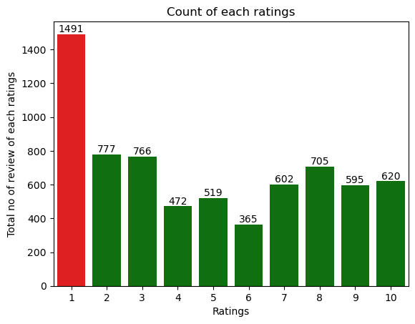
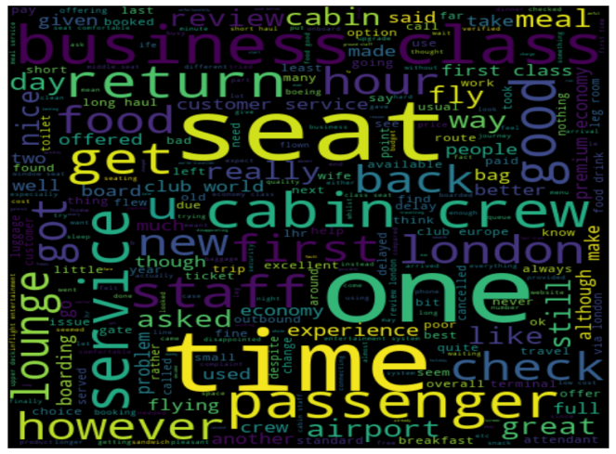
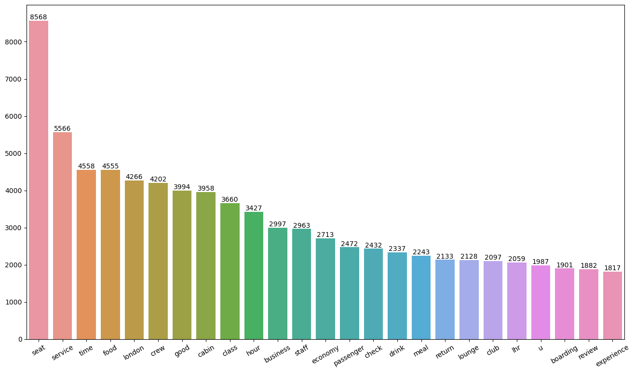
Key findings
Average Rating
4.83/10
Total Country reviewed
70
Total Review collected
6912
Positive :
Most Positive review is about Cabin crew service and staff, general economy seats. Many customer travelled in Business class.
Focus Needed on :Economy class service, seats, enhance in-flight entertainment experience and importantly Delays. Enhance the experience of business class, it seems customers want value for money. Improve Customer service on refund requests and process.
Customer reviews based on ratings(Positive and Negative)
7-10 ratings wrote about comfortable seats, good in-flight entertainment, decent food quality, on time arrival.
4-6 ratings faced problem with small entertainment screen, long passport check queue, bad business class experience.
1-3 ratings wrote dissatisfaction on congested middle seat and small screen while they liked the seats and the food, refund issue

